Slide 1
Managing Meetings Like a Leader
Dave Phillips, CAE

Slide 2
Manage Meetings Like a Leader
Setting the Tone Early and Often
Use the Agenda, Don’t Have an Agenda
Follow the Plan
Practicing Transparency
Know the Rules Before You Break Them

Slide 3
Setting the Tone
Early and Often

Slide 4
Notes:
Where you sit is important to the dynamics of a meeting. The Leader should sit at the head of the table so everyone can see you and you can see them. The power players in the meeting typically grad a seat at the corner and the less dominate personalities site along the sides of the table. The person sitting at the opposite end of the table is also key. It is best to have a friendly face at the opposite end.
What’s the key thing for a president at the first meeting that we discussed last time? Be on time. If you arrive early and start the meeting on-time, other will adapt to your habit and arrive on-time. If you are late or don’t start the meeting ontime, the will adapt to that and show up late every time.
The president sets to tone with their actions and others will follow. Your style will be mirrored by others. If you are all business then that’s the tone others will take. If you are more social, or funny or pessimistic, the rest of the group will mirror that style. So decide what tone you want to set and try to be consistent from meeting to meeting.
The worst tone you can set is that being the leader is a burden. Sometimes leaders complain about how many hours they having to put in or what a pain it is to do a certain presidential task. Most of the time this is done to garner sympathy or praise, but the actual results are damaging. What members hear when the leader complaints about being the leader is that it is a terrible job to aspire to. Instead, the leader needs to be positive about their role and express gratitude for the opportunity to serve. This will inspire others to want to become the leader.
Finally on the tone setting front, keep the meeting on track. If at the first meeting you allow the group to go down a few rabbit holes, they will continue to do so. If you use some guiding language to steer them back to the agenda, you will be seen as a good leader.

Slide 5
Use Guiding Language
Be careful to avoid “you” when you can use “we.” We have gotten into the weeds on this issue, let’s bring this to a conclusion and move on.
To deal with the over-talkative participant – George has done an excellent job of letting us know his thoughts, who else has something to add.
Stopping a bully – I’d like to remind everyone that it is critical to our success that we respectfully listen to others comments and keep an open mind.
Helping the quiet ones – Betty, I’d love to hear your thoughts about this issue.
Stopping redundant discussion – We’ve had some great discussion. Are there any new thoughts that haven’t been expressed that we need to cover?

Slide 6
Use the Agenda…
…Don’t Have an Agenda
Notes:
As a leader, you are generally in charge of setting the agenda for the meeting. This is a power that we see abused in a political setting often, so you need to be careful to send the right message to others that indicates you are open to their ideas. Actively seek input from others for agenda items and unless the topic is inappropriate include it on the agenda.
In addition to determining the agenda for the meeting, the leader also can decide the order of topics. In most cases, participants are most engaged and early in the agenda. For the best results, put the most important topics early in the agenda to take advantage of the participants energy and leave less important things until the end. If you have a topic that is emotionally charged and NOT important, put it last on the agenda so it does not distract from more important items.

Slide 7
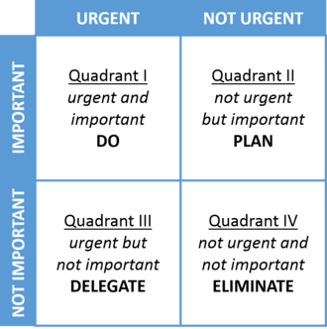
Stephen Covey’s
Quadrants
Notes:
Famed business guru Stephen Covey came up with this quadrant diagram to help decide what’s important and what’s not? Quadrant 4 topics should never be on the agenda and the other three quadrants will probably help in organizing the agenda with Quad 1 items first, followed by 2 and 3.

Slide 8
I don’t want to be the leader
If I can’t speak to issues I care about.
Notes:
As this slide indicates, a leader should NOT share their opinion on an agenda item. It is against Roberts Rules of Order and unfair to others. As leader, you control the meeting flow and discussion. It would be inappropriate to also try to influence the outcome of a discussion by sharing your opinion. In a small, informal meeting of 3-5 people, it is probably not a big deal, but a Board of Directors meeting or other decision-making body it would be considered inappropriate.
If a leader really wants to speak to an issue, then they should turn over the control of the meeting during the entire discussion of that agenda item. Then, like every other participant, you may discuss the matter.

Slide 9
Follow the Plan
Notes:
If you are leading the chapter Board meeting and you have a strategic plan, this should be the most important item on the agenda. Even if it is just an update as to the status of the plan, keep your strategic plan top of mind.
If your chapter does not have a strategic plan, just use the Covey Quadrants to decide what’s important on the agenda.

Slide 10
Practicing Transparency

Slide 11
Transparency
Builds Trust
Builds Interest
Builds Credibility

Slide 12
What is “transparency?”
“Candid, open, or frank. Free of deceit.”

Slide 13
What is transparency?
Tell them what you are considering
Ask for their input
Tell them who is involved in the decision
Tell them how and when the decision will be made
Tell them what the decision is and why it was made

Slide 14
Transparency
It is no longer a matter of seeing “through,” it is now about seeing “into.”

Slide 15
In the absence of information, it is human nature to fill the void with negative assumptions
Notes:
If your child is out past curfew, it is human nature to start applying all of the worse case scenarios instead of positive explanations. Your members will assume the worse if you do not open your process and give them as much information as possible.

Slide 16
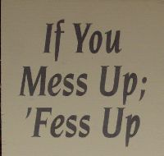
Mistakes Happen

Slide 17
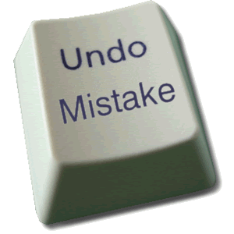
Damage Control
Mess up……
Fess up……
Dress up……

Slide 18
Know the Rules…
…Before You Break Them

Slide 19
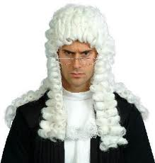
Robert's Rules were first published in 1876… …and they have been preventing associations from getting stuff done ever since.

Slide 20
Bobby’s Suggestions
Robert’s Rules are archaic (1876)
Designed for keeping order, not making decisions
Know Robert’s Rules, but don’t use them all the time

Slide 21
Discussion Before Debate
Debates are confrontational
Discussions are collaborative
Most Committee decisions are collaborative

Slide 22
Discussion Before Deliberation
Issue:
Should we change the date of the annual meeting to December?

Slide 23
Summary Tips for Leading the Meeting
Start on Time
Talk less, facilitate more
Get everyone involved
Keep group focused on agenda items
Pass clear motions to document results
End on time (or early)

